Slide 1
Modeling the Residential EV Charging Load
Presented by: Lily Gittoes
August 27, 2026

Slide 2
Motivating Questions
1. How does a TOU rate change the amount and timing of residential electricity demand compared with a flat rate, and how does this effect vary as EV adoption increases?
2. How much can EV owners save on their electricity bills by choosing a TOU rate instead of a flat rate?
Presentation Agenda:
Walk through EV demand model (for ResStock (2024) buildings)
Present Maryland simulation results for baseline ResStock (2024) scenario
Discuss key takeaways for the design of TOU rates for EVs

Slide 3
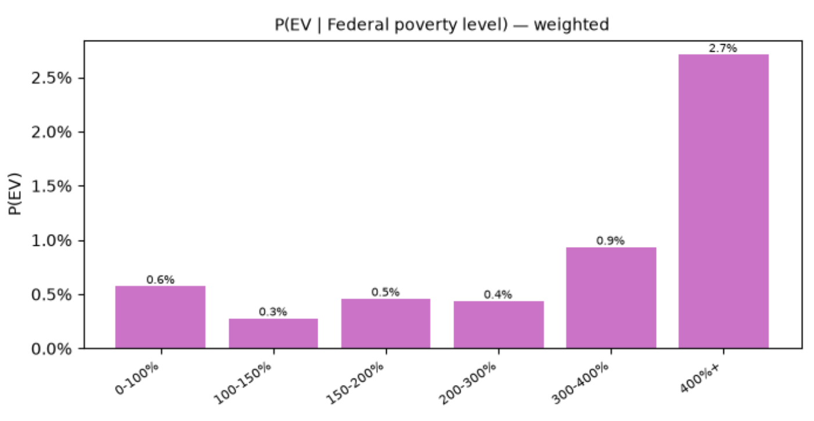
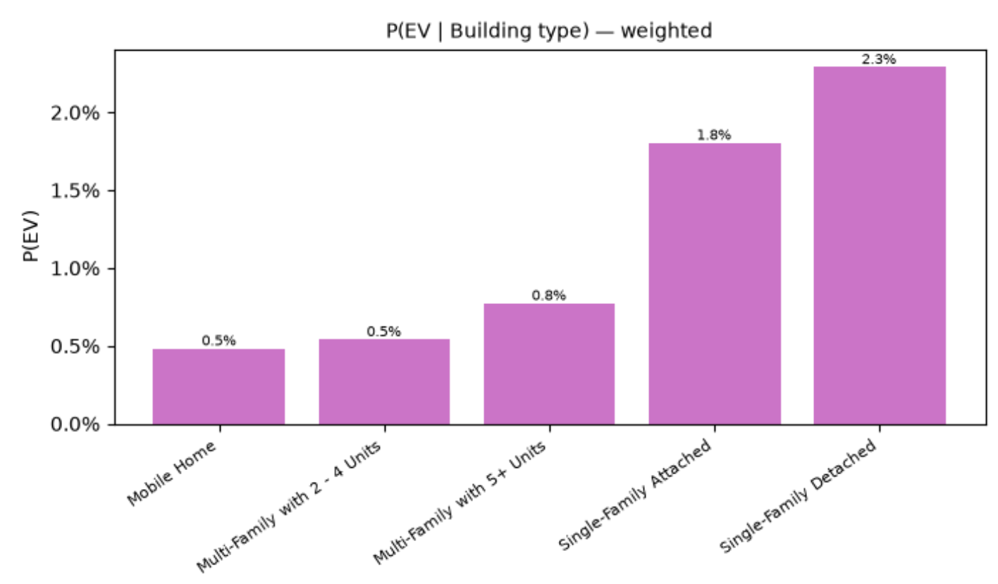
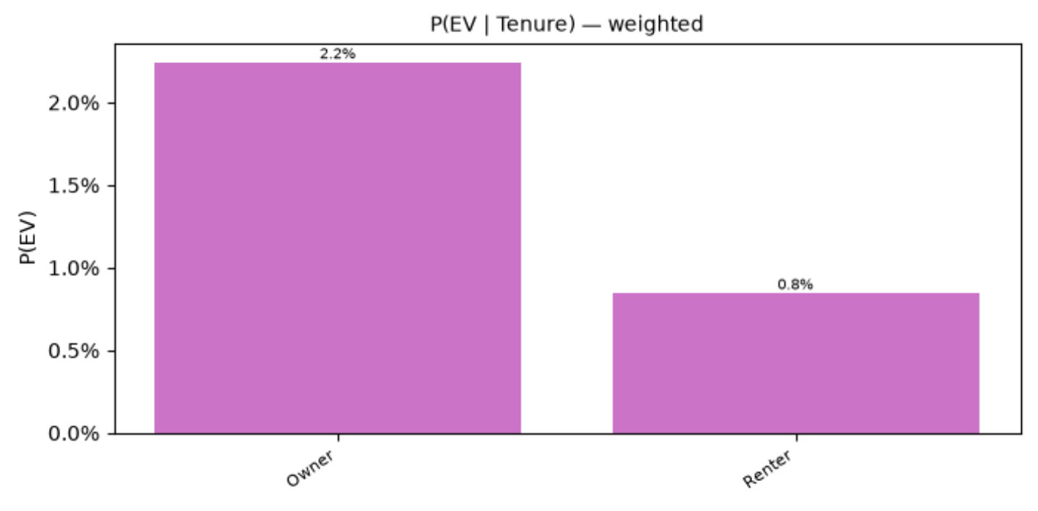
Step 1: Model EV Adoption
ResStock (2025) gives EV ownership rates by:
Federal poverty level (FPL)
Building type
Tenure
PUMA
Assumptions:
Each household has at most 1 EV
Vacant units do not have EVs
Plots of EV ownership rates by segment (weighted by PUMS source weights):

Slide 4
Step 1: Model EV Adoption
ResStock (2024) metadata_df (MD):
Bernoulli sampling!
bldg_id | fpl | building_type | puma | tenure | P(EV) | EV
3870 | 400%+ | SF Detached | MD, 01001 | Owner | 0.047 | 1
142 | 400%+ | SF Detached | MD, 01203 | Owner | 0.029 | 0
295 | 200-300% | SF Detached | MD, 01600 | Renter | 0.002 | 0
Scaling to future EV adoption:
Set target adoption rate p%
Scale ResStock (2025) rates linearly (cap at 1 and fill segments with zero rates last)
Relation to TEMPO:
TEMPO model outputs EV stock in 3 scenarios (baseline, high electrification, and all EV sales by 2035)
ResStock (2025) EV adoption rates are aligned with TEMPO baseline year (2023)
Notes:
Add more visualizations along the way. Like visualize demographic data influencing trip profiles for example
Representation of load shifting under different assumptions

Slide 5
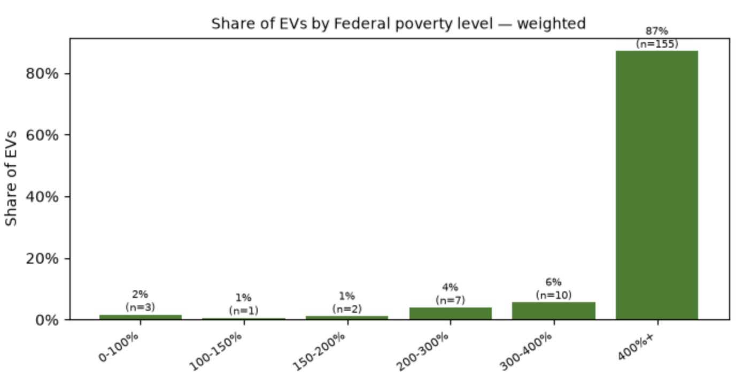
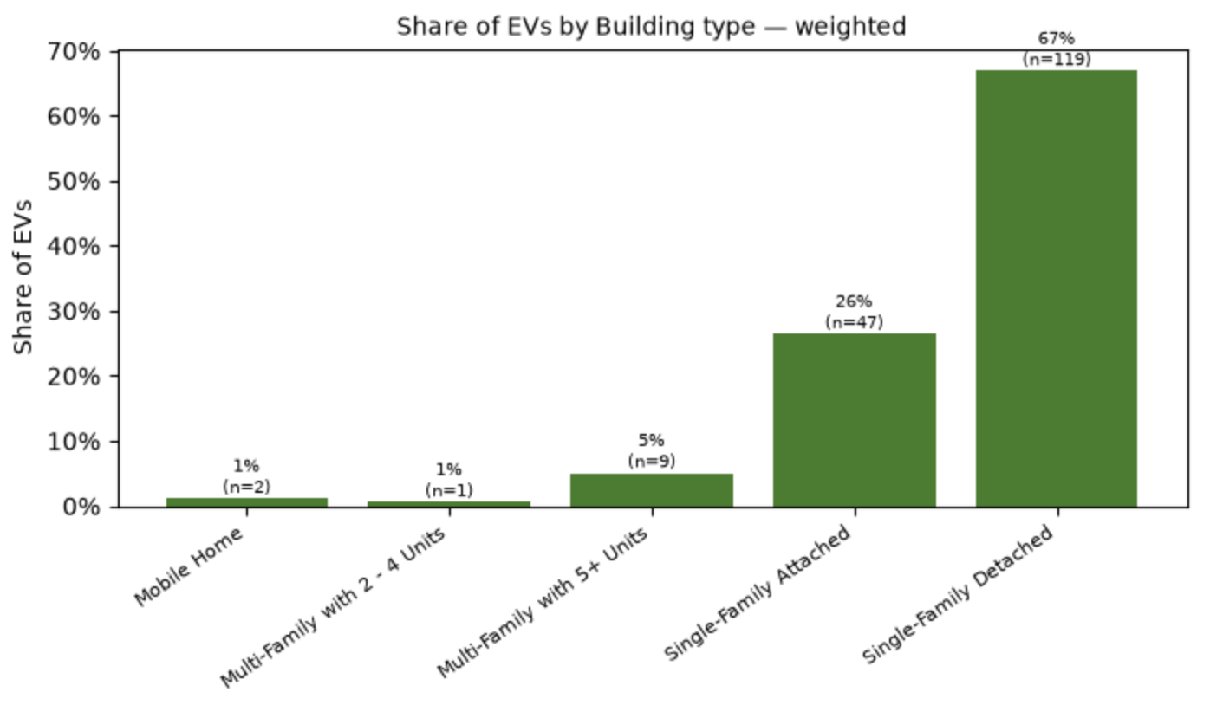
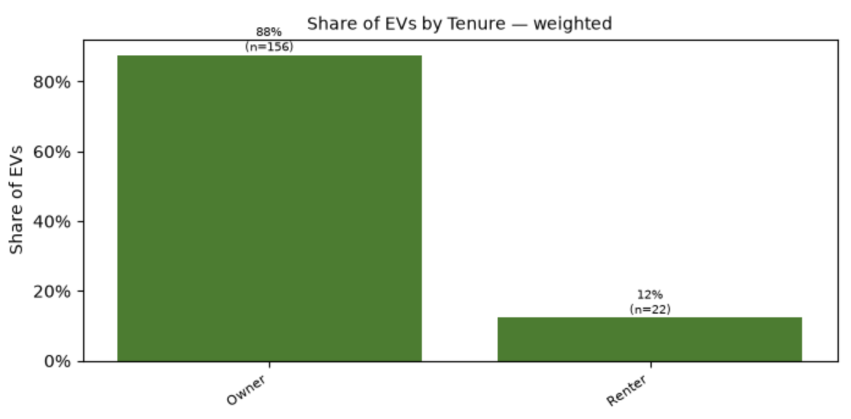
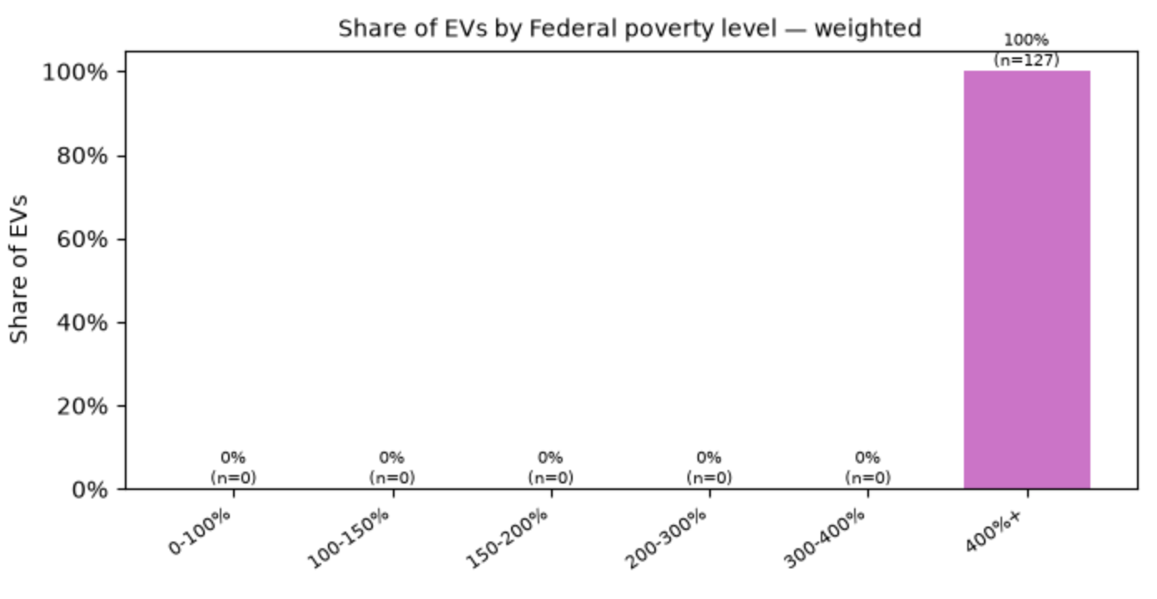
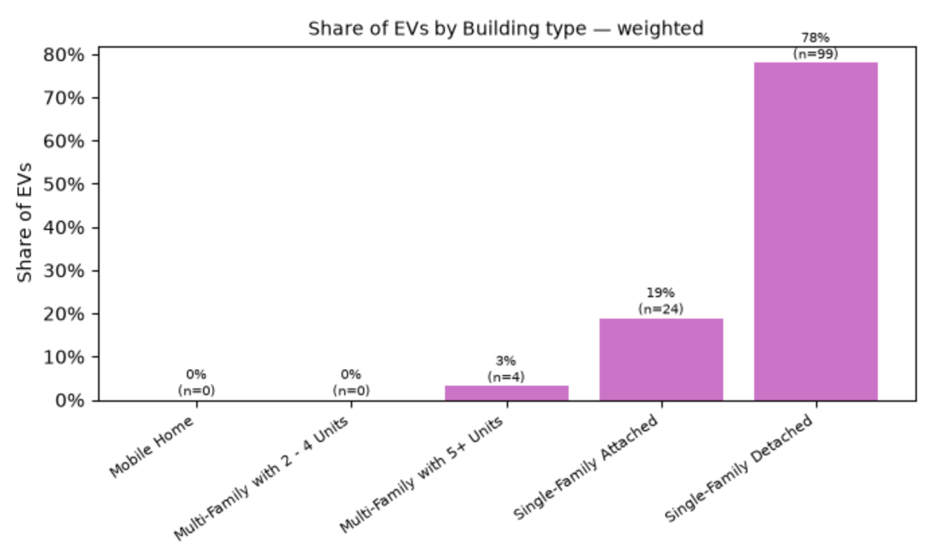
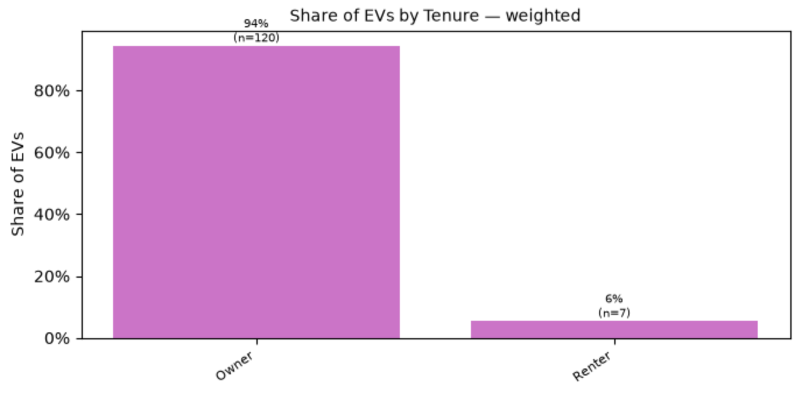
Step 1: Model EV Adoption
ResStock (2024) MD sampled EV ownership rates by segment (apply ResStock Building weights):
ResStock (2025) MD Sampled EV ownership rates by segment (apply ResStock Building weights):
Notes:
Add more visualizations along the way. Like visualize demographic data influencing trip profiles for example

Slide 6
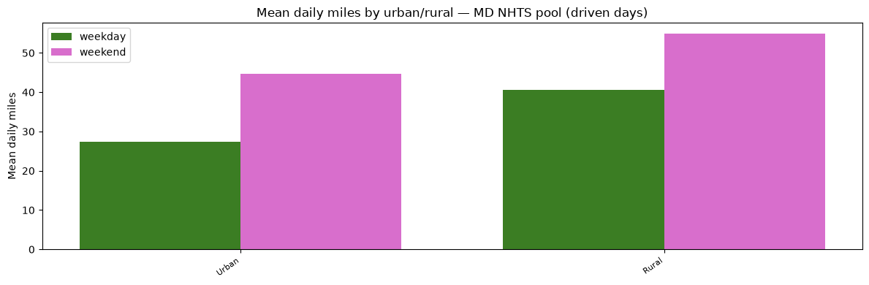
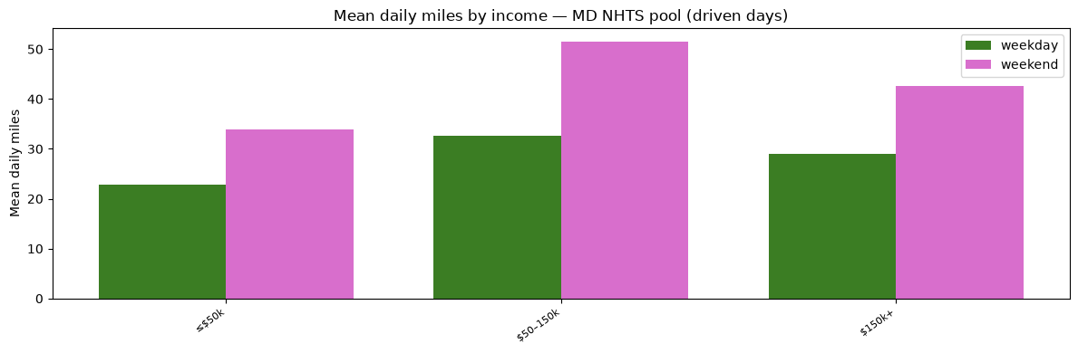
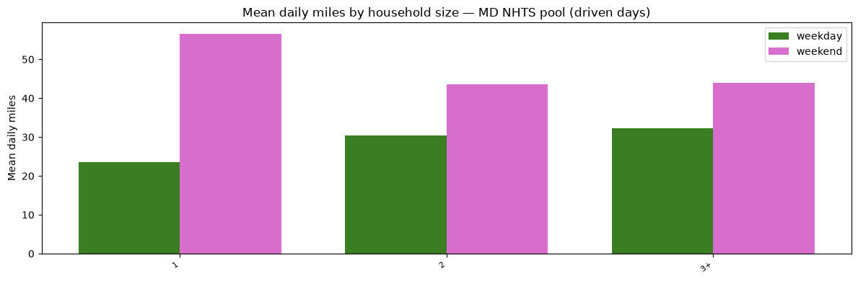
Step 2: Assign Driving Profiles
Participants in NHTS (2022) logged all their trips over a 24-hour period:
Each trip log includes:
Start and end time
Why from and why to
Miles traveled
Plot daily miles traveled by:
Weekday vs. weekend
Urban vs. rural status
Income bucket
Number of occupants
Notes:
Note that plots are before filtering!

Slide 7
Step 2: Assign Driving Profiles
Filter light-duty vehicles in NHTS (2022) dataset:
At least one logged trip (no idle vehicles)
Feasible to charge and complete trips with largest battery + level 2 charger + 20% buffer
ResStock (2024) metadata_df:
bldg_id | urban | income | occupants | EV | weekday_vehicle_profile | weekend_vehicle_profile
3870 | 1 | 75k | 2 | 1 | (11,12,6.58,1,14), (11,12,2.44,14,14), (15,16,4.65,14,13), (17,18,2.92,13,1) | (11,12,7.18,1,19), (12,14,7.60,19,1)
14133 | 1 | 90k | 3 | 1 | (9,10,24.06,1,3), (18,19,25.85,3,1) | (13,14,0.92,1,12), (13,14,0.88,12,1)
22397 | 1 | 300k | 3 | 1 | (8,9,3.97,1,16), (10,11,3.99,16,1) | (9,10,0.57,1,19), (10,11,0.58,19,1)
NHTS why from & why to keys: 1=home, 3=work, 12=buy groceries, 13=buy services, 14=buy meals, 16=exercise, 19=social/recreational

Slide 8
Step 3: Simulate Annual Travel
Generate an annual trip profile by stitching together random realizations from vehicle profiles.
For each building with an EV in ResStock (2024):
Monday, Jan 1, 2018:
For each trip:
Draw random departure and arrival offsets from:
Draw miles traveled from:
~N(miles, (0.1*miles)^2)
-2 | -1 | 0 | 1 | 2
0.05 | 0.10 | 0.70 | 0.10 | 0.05
Add an additional trip that moves the vehicle at home or away if needed (to ensure smoothness across days)
Repeat to get an annual travel schedule!
Notes:
See if we can compare our distribution of EV daily miles traveled against 2025

Slide 9
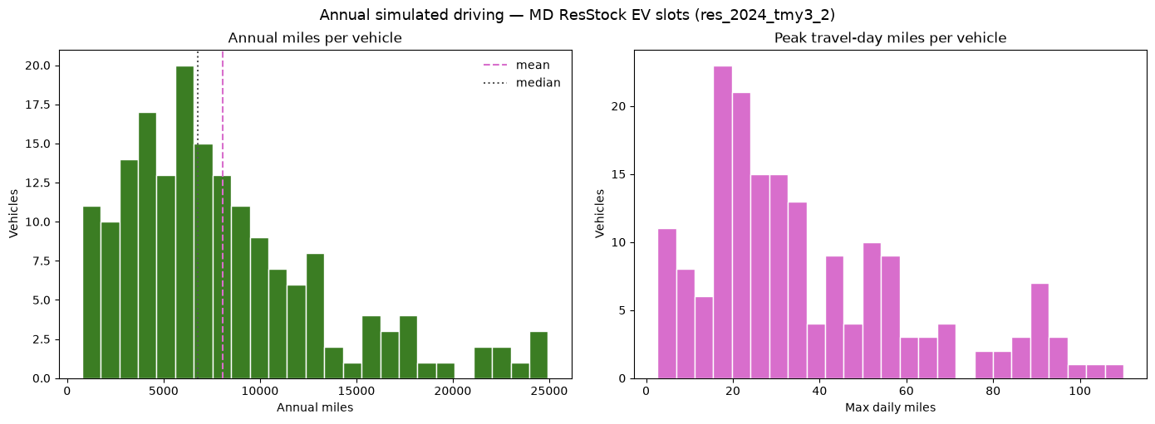
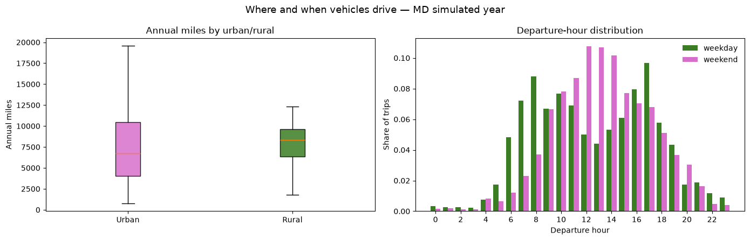
Step 3: Simulate Annual Travel
Summary of ResStock (2024) MD simulated annual travel profiles:
Notes:
See if we can compare our distribution of EV daily miles traveled against 2025

Slide 10
Step 4: Assign Battery Characteristics
ResStock (2025) allows for 7 EV types:
EV Types:
Compact (200 or 300 mi range)
Midsize (200 or 300 mi range)
SUV (200 or 300 mi range)
Pickup (300 mi range)
P(EV type | own EV)
Draw EV type from distribution of vehicle types that can cover max daily miles + 20% buffer and is feasible with a Level 2 charger.
ResStock (2024) metadata_df:
bldg_id | EV | max daily miles | EV option | capacity (kWh) | kWh/mi
3870 | 1 | 30.6 | SUV (300 mi) | 83.68 | 0.2789
14133 | 1 | 100.4 | Compact (200 mi) | 40.17 | 0.2099
22397 | 1 | 16.0 | SUV (300 mi) | 83.68 | 0.2789

Slide 11
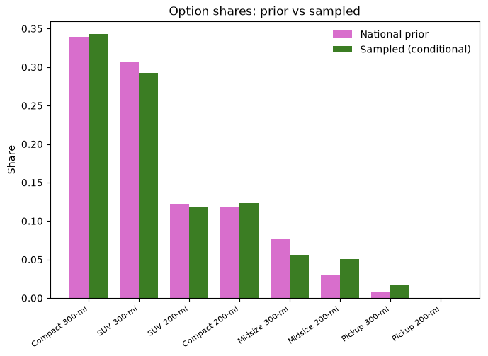
Step 4: Assign Battery Characteristics
EV Types in ResStock (2024) MD Sample:
Headroom (miles) = battery capacity (kWh) / efficiency (kWh/mi) – max daily miles
Mean | 206.25
Standard Deviation | 61.27
Minimum | 35.43
Maximum | 295.29

Slide 12
Step 5: Home Charging Fraction
ResStock (2025) has home charging fractions by segment:
FPL
Building type
P(Home charging fraction | own EV)
Assumption: fraction applied uniformly to all discharge!
ResStock (2024) metadata_df:
bldg_id | fpl | building_type | EV | Home charging fraction
3870 | 400%+ | SF Detached | 1 | 1.0
14133 | 400%+ | SF Detached | 1 | 0.7
22397 | 400%+ | SF Detached | 1 | 1.0

Slide 13
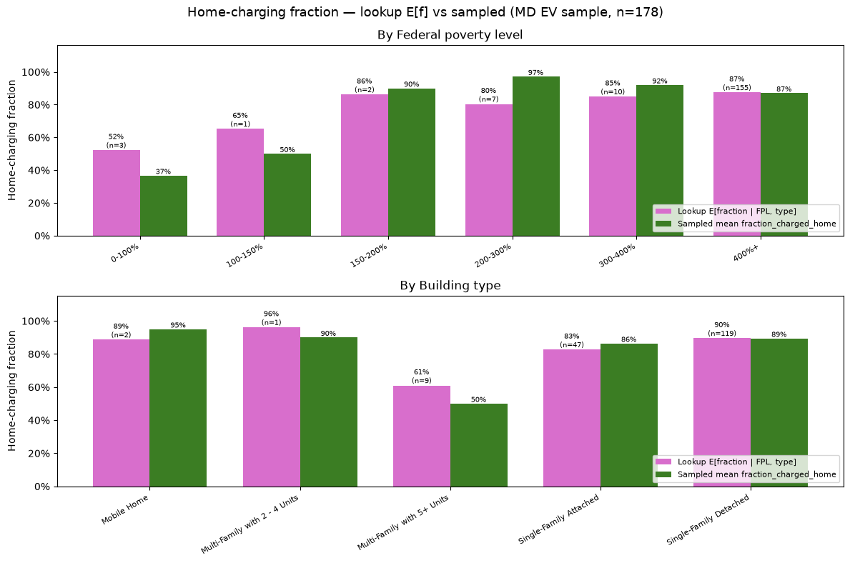
Step 5: Home Charging Fraction
Home Charging Fractions in ResStock (2024) MD Sample:

Slide 14
Step 6: Assign Charger Characteristics
ResStock (2025) provides probabilities of level 1 or 2 charger by segment:
FPL
Building type
Tenure
P(charger type | own EV)
Draw charger type from distribution of chargers that are feasible with a perfect-foresight home immediate charging policy + 20% buffer.
ResStock (2024) metadata_df:
bldg_id | fpl | building_type | tenure | EV | Charger type
3870 | 400%+ | SF Detached | Owner | 1 | Level 1 (1.6 kW)
14133 | 400%+ | SF Detached | Owner | 1 | Level 2 (7.2 kW)
22397 | 400%+ | SF Detached | Owner | 1 | Level 1 (1.6 kW)

Slide 15
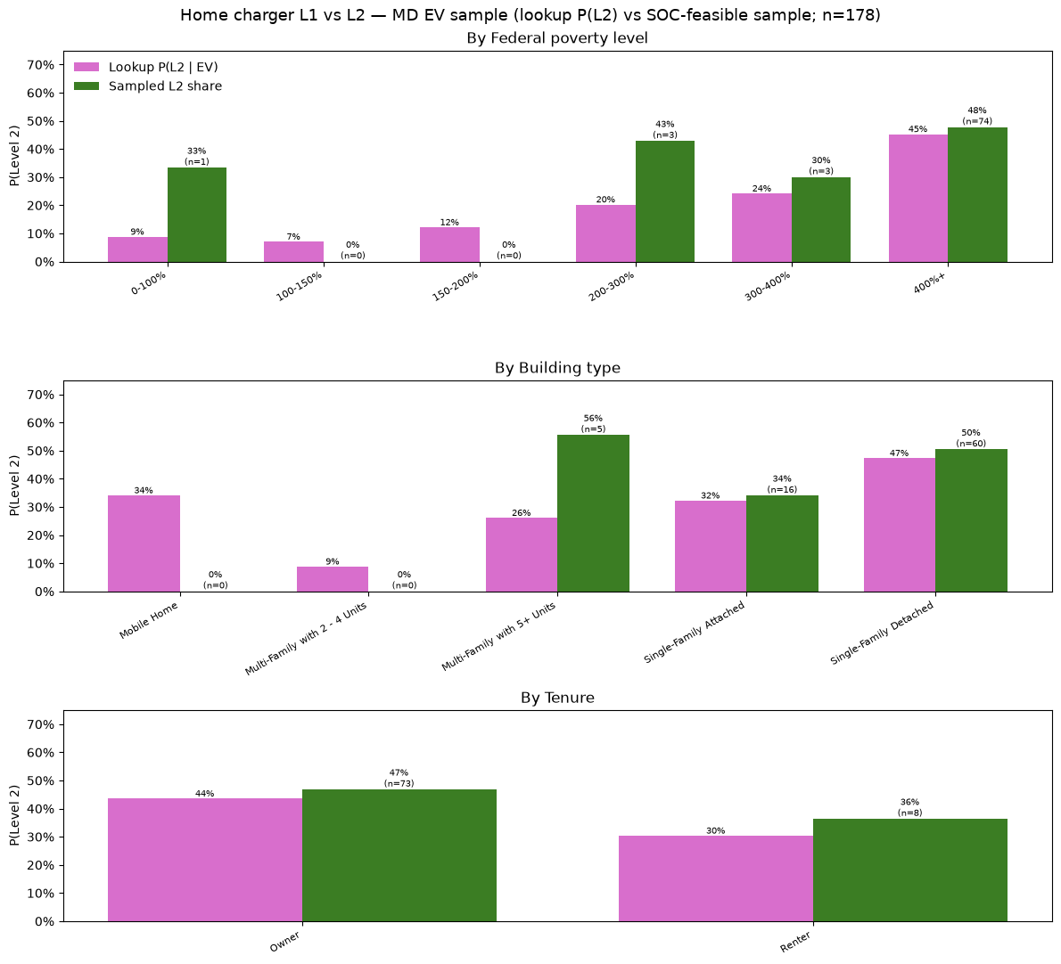
Step 6: Assign Charger Characteristics
Charger Types in ResStock (2024) MD Sample:

Slide 16
Assumptions in Steps 2-5
Assumptions:
One-to-one correspondence between NHTS participant travel schedule and vehicle trip profile.
NHTS surveys are filtered to consider one person’s trips in one vehicle.
Assumption: each EV is only driven by one owner.
Urban/rural flags in NHTS profiles are matched to in.puma_metro_status flag in ResStock data (which may not be exact).
Weekend and weekday travel profiles are different but they are consistent year round.
No explicit dependence between owning an EV and trip profiles.
E.g., EV owners might take shorter trips, or maybe they drive more because charging a car is cheaper than owning a gas-powered vehicle.
No correlation between EV schedule and rest of home base load (e.g., dishwasher, washing machine, HVAC, etc.)

Slide 17
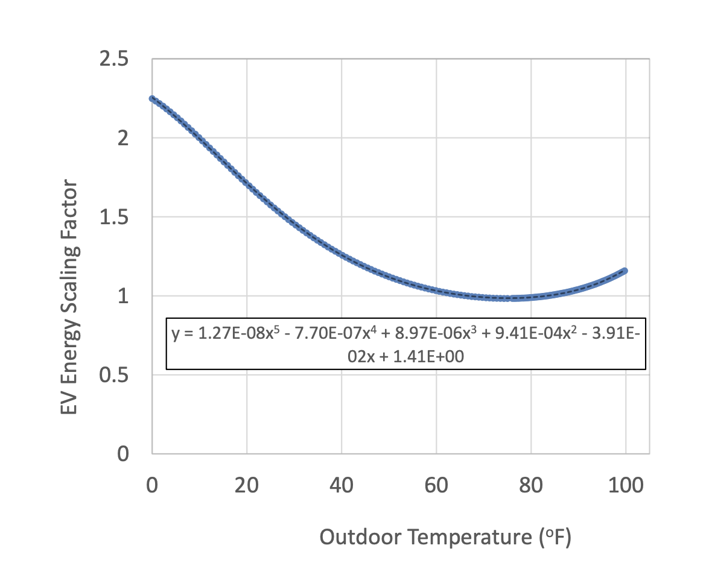
Step 7: Model at home/away & discharge
From each EV owner’s travel schedule + vehicle type, we can construct the table:
Datetime | EV at home | Discharge (kWh)
Jan 1, 2018, 10am | 1 | 0
Jan 1, 2018, 11am | 0 | 2.976
Jan 1, 2018, 12pm | 0 | 0
Jan 1, 2018, 1pm | 0 | 1.033
Jan 1, 2018, 2pm | 0 | 0
Jan 1, 2018, 3pm | 0 | 1.730
Jan 1, 2018, 4pm | 0 | 0
Jan 1, 2018, 5pm | 0 | 0.595
Jan 1, 2018, 6pm | 0 | 0.589
Jan 1, 2018, 7pm | 1 | 0
Ex: bldg_id=3870 in ResStock (2024)
Apply temperature scaling factor to get kWh discharged:
Assumption: miles are split uniformly among hours for each trip.

Slide 18
Step 8: Choose Charging Policy
Datetime | EV at home | Discharge (kWh) | State of charge (kWh)
Jan 1, 2018, 10am | 1 | 0 | 83.68
Jan 1, 2018, 11am | 0 | 2.976 | 83.68
Jan 1, 2018, 12pm | 0 | 0 | 80.704
Jan 1, 2018, 1pm | 0 | 1.033 | 80.704
Jan 1, 2018, 2pm | 0 | 0 | 79.670
Jan 1, 2018, 3pm | 0 | 1.730 | 79.670
Jan 1, 2018, 4pm | 0 | 0 | 77.940
Jan 1, 2018, 5pm | 0 | 0.595 | 77.940
Jan 1, 2018, 6pm | 0 | 0.589 | 77.345
Jan 1, 2018, 7pm | 1 | 0 | 76.756
Jan 1, 2018, 8pm | 1 | 0 | 76.756
Jan 1, 2018, 9pm | 1 | 0 | 78.356
Charging Policies:
Immediate: charge as soon as vehicle returns home at max power until full or leaves for next trip
TOU immediate: charge at start of off-peak period at max power until full or leaves for next trip (with emergency on-peak charging)
Ex: bldg_id=3870 cont’d

Slide 19
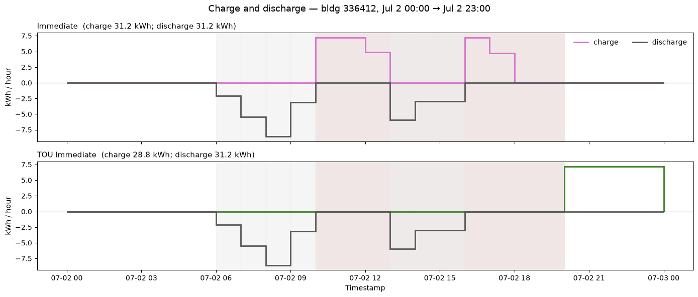
Step 8: Choose Charging Policy
Sample day of bldg_id=336412 in ResStock (2024):
BGE Summer TOU rate for EVs (SOS only):
On-peak (10am-8pm): 23.636 cents/kWh
Off-peak (all other hours): 9.981 cents/kWh
Under the TOU Immediate policy, charging is shifted to start at 8pm!

Slide 20
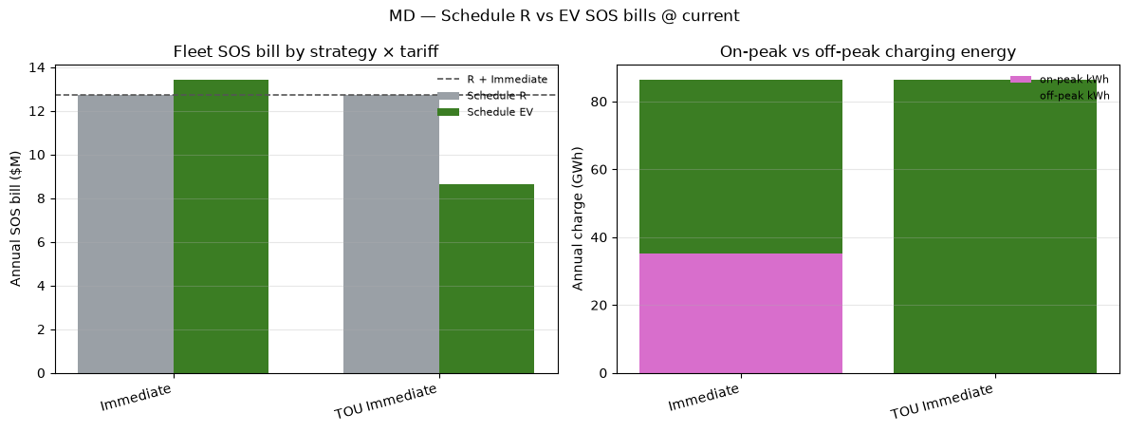
Total Bill Payments under TOU rate
Total annual SOS bills for EV charging and total charging by peak period in MD ResStock (2024) sample. Both plots are stock-weighted.
If all Maryland households with EVs use the TOU immediate policy, then the TOU rate allows them to save $4.4 million collectively over the year.

Slide 21
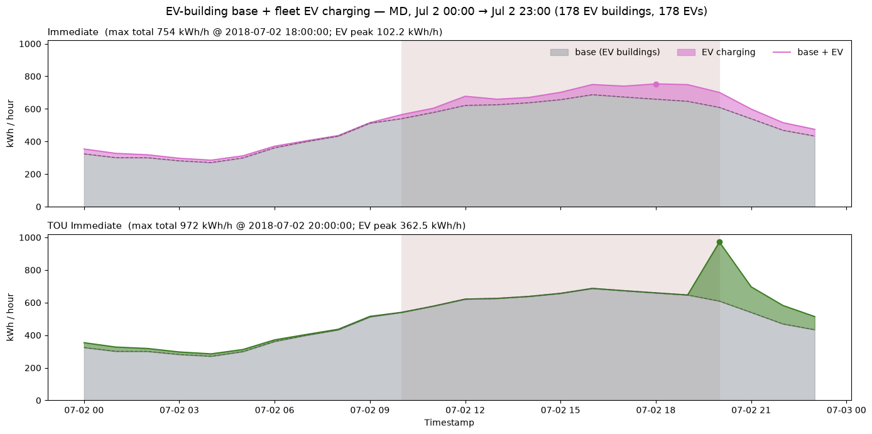
Aggregate Charging Load
ResStock (2024) MD EV aggregate charging load + base load sample:
Peak Hourly EV + Base Load (kWh)
Immediate | 1028
Off-peak immediate | 1278

Slide 22
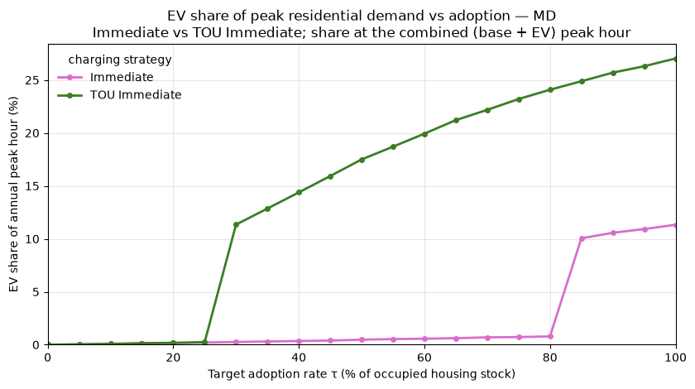
Peak Demand as EV Adoption Scales
ResStock (2024) MD EV share of peak residential demand
At higher EV adoption levels:
TOU rate creates new demand peak
Future work should stagger charging or consider other rate types (e.g., demand charges)

